Slide 1


Slide 2

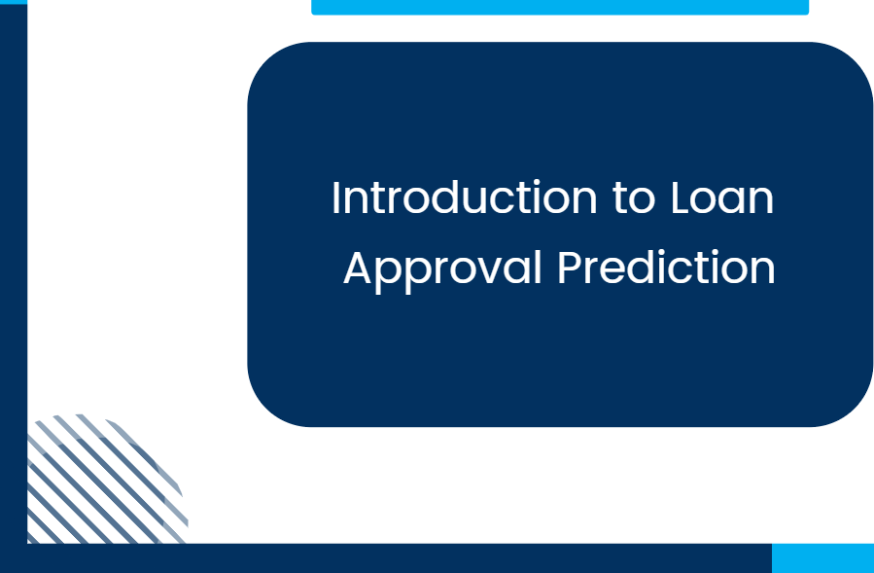
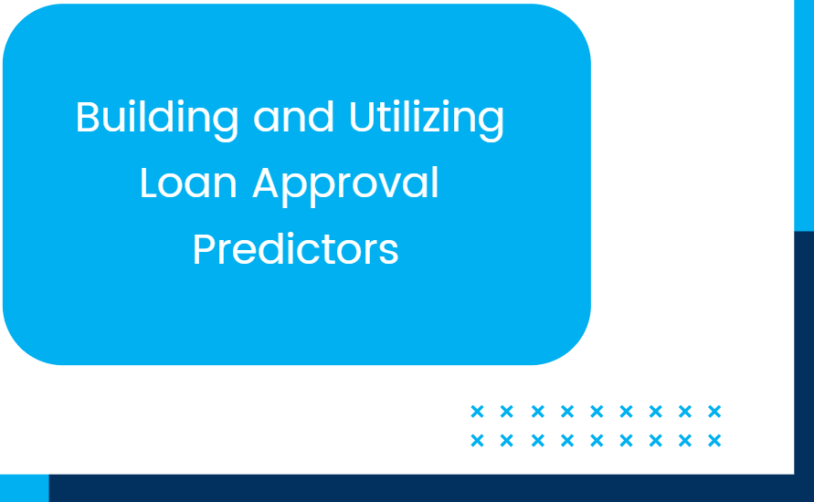
• • • • • • ••• • • • • • • •
• • • • • • ••• • • • • • • •
• • • • • • •••• • • • • • •
• • • • • • • • • • • • • •
^{s} 01
02

Slide 3

''overview of Loan Approval Process
Traditional Loan Approval Methods
Manual evaluation of borrower information by loan officers to determine creditworthiness and risk.
Key Factors Affecting Loan Decisions
Income, credit history, employment status, debt- to- income ratio, and collateral influence approval outcomes.

Slide 4
''Role of Prediction Models
Importance of Predictive Analytics
Enhances accuracy and efficiency by using data- driven insights to assess loan applicant risk.
Common Types of Loan Approval Predictors
Logistic regression, decision trees, and machine learning algorithms commonly predict loan approval chances.

Slide 5


Slide 6


''Data and Features Used in Prediction
Customer
Financial
Information
Credit History and Behavioral
Data
Includes income, employment status, existing debts, and financial stability indicators used to assess loan repayment ability.
Involves credit scores, past loan repayment behavior, and spending patterns to evaluate creditworthiness.

Slide 7

''Techniques and Technologies
Machine Learning Algorithms
Use of models like decision trees, random forests, and neural networks to accurately predict loan approval outcomes.
Implementation Challenges and Solutions
Addresses data quality, model bias, and integration issues with practical strategies for effective deployment.

Slide 8


